Slide 1
Color Your Future
By Bailey Sostek and Drew Tisdelle

Slide 2
Updates
Visible warp points
Arrows to show if the player can move in a certain direction
3 additional pieces of music
Sky area with puzzles and NPCs to talk to
Volcano area with puzzles and NPCs to talk to
Minor updates to existing areas

Slide 3
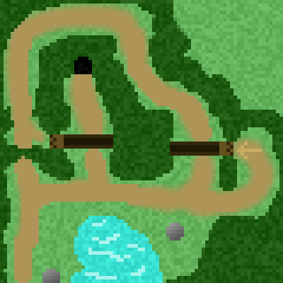
Forest

Slide 4
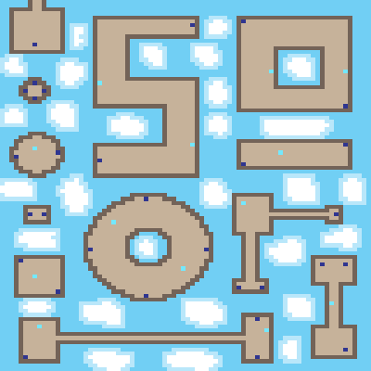
Sky

Slide 5
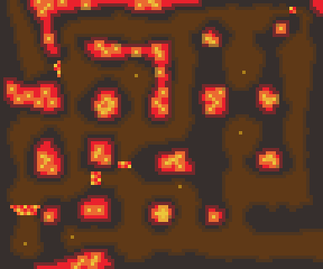
Volcano

Slide 6
Quick Demo
http://users.wpi.edu/~bhsostek/asign20/game.html

Slide 7
Bailey Sostek
Whither final level redesign

Slide 8
Current Emotions
Frustration
Anger
Insignificance

Slide 9
New Emotion

Slide 10
Drew Tisdelle
Redesign for Whither’s Final Level

Slide 11
Emotions to be Evoked
Anxiety
Frustration
Despair
Finality

Slide 12
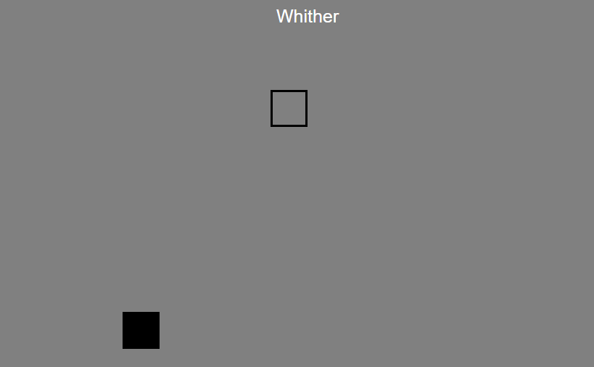

Slide 13
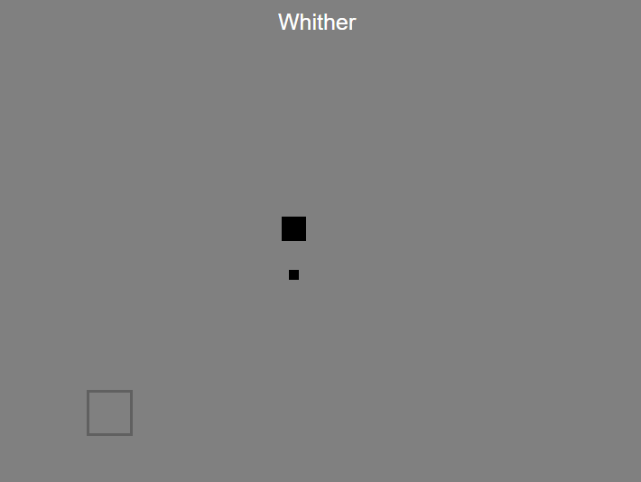

Slide 14
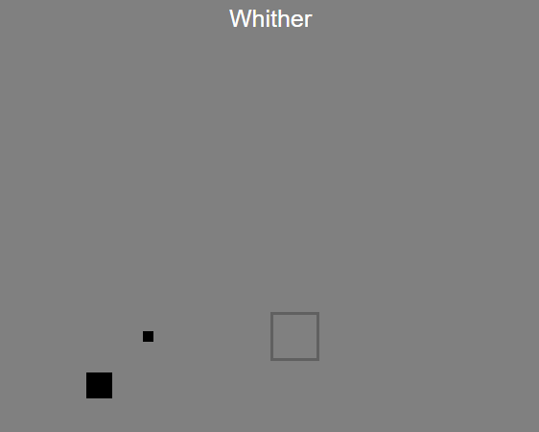

Slide 15
